Slide 1

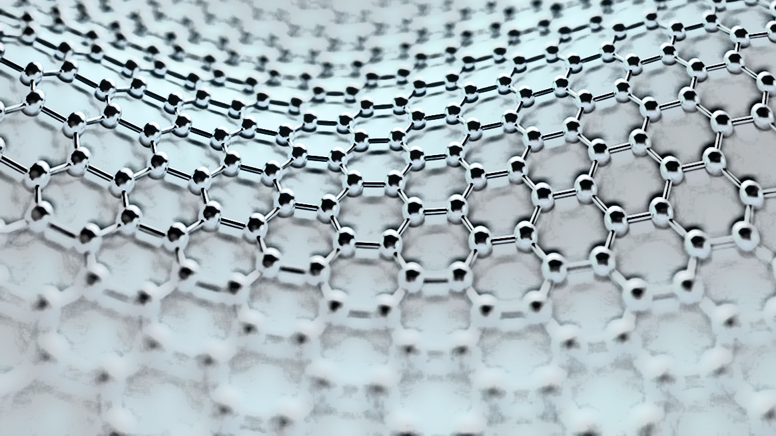

KLAYTNWATCH

Slide 2
ABOUT THE PROJECT
A DEFI DASHBOARD ON KLAYTN NETWORK.
WEBSITE LINK::: https://klaytnwatch.netlify.app/
A LITTLE WRITEUP ABOUT KLAYTN BLOCKCHAIN IS ON THE HOME PAGE
THE WEB APPLICATION DISPLAY TOKEN(S) IN WALLET, THE AVAILABLE BALANCE, THE VALUE IN USD OF THE TOKENS.
ALSO ADDED A FEATURE CALLED PWA, WHICH ALLOWS USERS TO DOWNLOAD THE APPLICATION AS A STANDALONE ON MOBILE OR DESKTOP, MORE ABOUT IT ON SLIDE SEVEN (7).
IT ALSO DISPLAYS THE NFT’S IN WALLET, NFT TOKEN ID, SMART CONTRACT (IF PROVIDED BY THE API), CURRENT FLOOR PRICE(IF PROVIDED BY THE API).
DARK MODE/LIGHT MODE ADDED.
FULLY RESPONSIVE ON MOBILE AND DESKTOP.

Slide 3
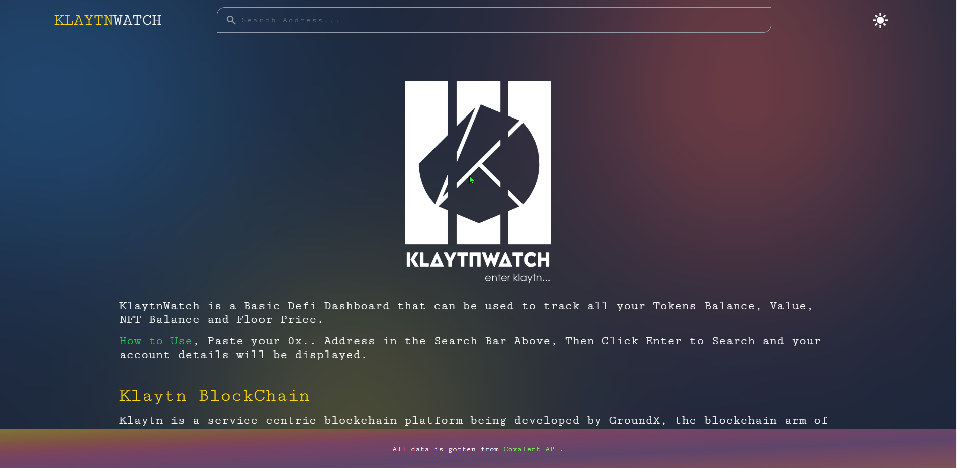
VIEW OF HOME PAGE

Slide 4
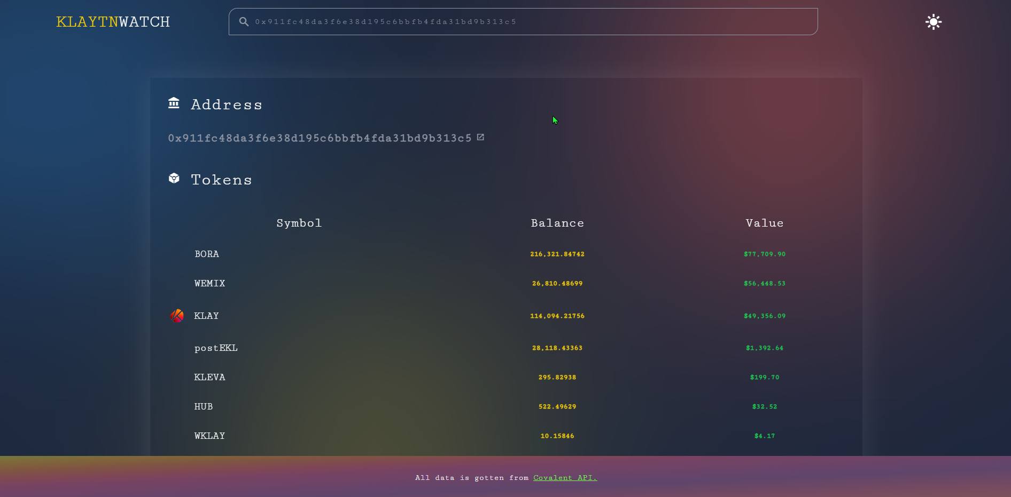
VIEW OF ADDRESS SEARCH RESULT

Slide 5
WHAT THE WEBSITE IS BUILT WITH.
PROGRAMMING LANGUAGE: (JAVASCRIPT, REACT.JS).
API IMPLEMENTED: WE USED COVALENT API TO FETCH DATA.
THEN FORMATTED THE DATA, THEN PASSED THE DATA TO BE DISPLAYED AND THEN TRANSFORMS THE DATA TO SUIT THE UI.
ALL CODES ARE WRITTEN FROM SCRATCH.
API USED ON NEXT SLIDE.

Slide 6
COVALENT API ENDPOINT’S USED
GET TOKEN BALANCES FOR ADDRESS
https://api.covalenthq.com/v1/:chain_id/address/:address/balances_v2/?&key=ckey_47958ac13e574573ab569f046e9
We used this Endpoint, then de-structured the data gotten from the API.
Klaytn Chain Id: 8217.
Address: Based on User Input.
API Key: Our own Generated API Key, gotten from https://www.covalenthq.com/

Slide 7
PROGRESSIVE WEB APP (PWA)
A Progressive Web App (PWA) is a website that looks and behaves as if it is a mobile app. PWAs are built to take advantage of native mobile device features, without requiring the end user to visit an app store, make a purchase and download software locally. Instead, a PWA can be located with a search engine query and accessed immediately through a browser.
It is installable on both Mobile and Desktop as an App.
This feature is added so as to further reach more users, as some prefer Mobile apps to using website.
The Mobile app can also be shared to other users just like the normal apps.

Slide 8
FUTURE PLANS FOR THE PROJECT.
ADD CHARTS FOR EACH TOKEN
IMPROVE ON THE UI/UX
ADD OTHER NFT DATA(S)(HISTORICAL FLOOR PRICE (FP))
PRICE CHART FOR KLAY AND OTHER TOP TIER CRYPTOCURRENCY.
WALLET CONNECTION USING KAIKAS AND METAMASK.
PERSEVERANCE FOR WALLET CONNECTIONS.
And more….

Slide 9
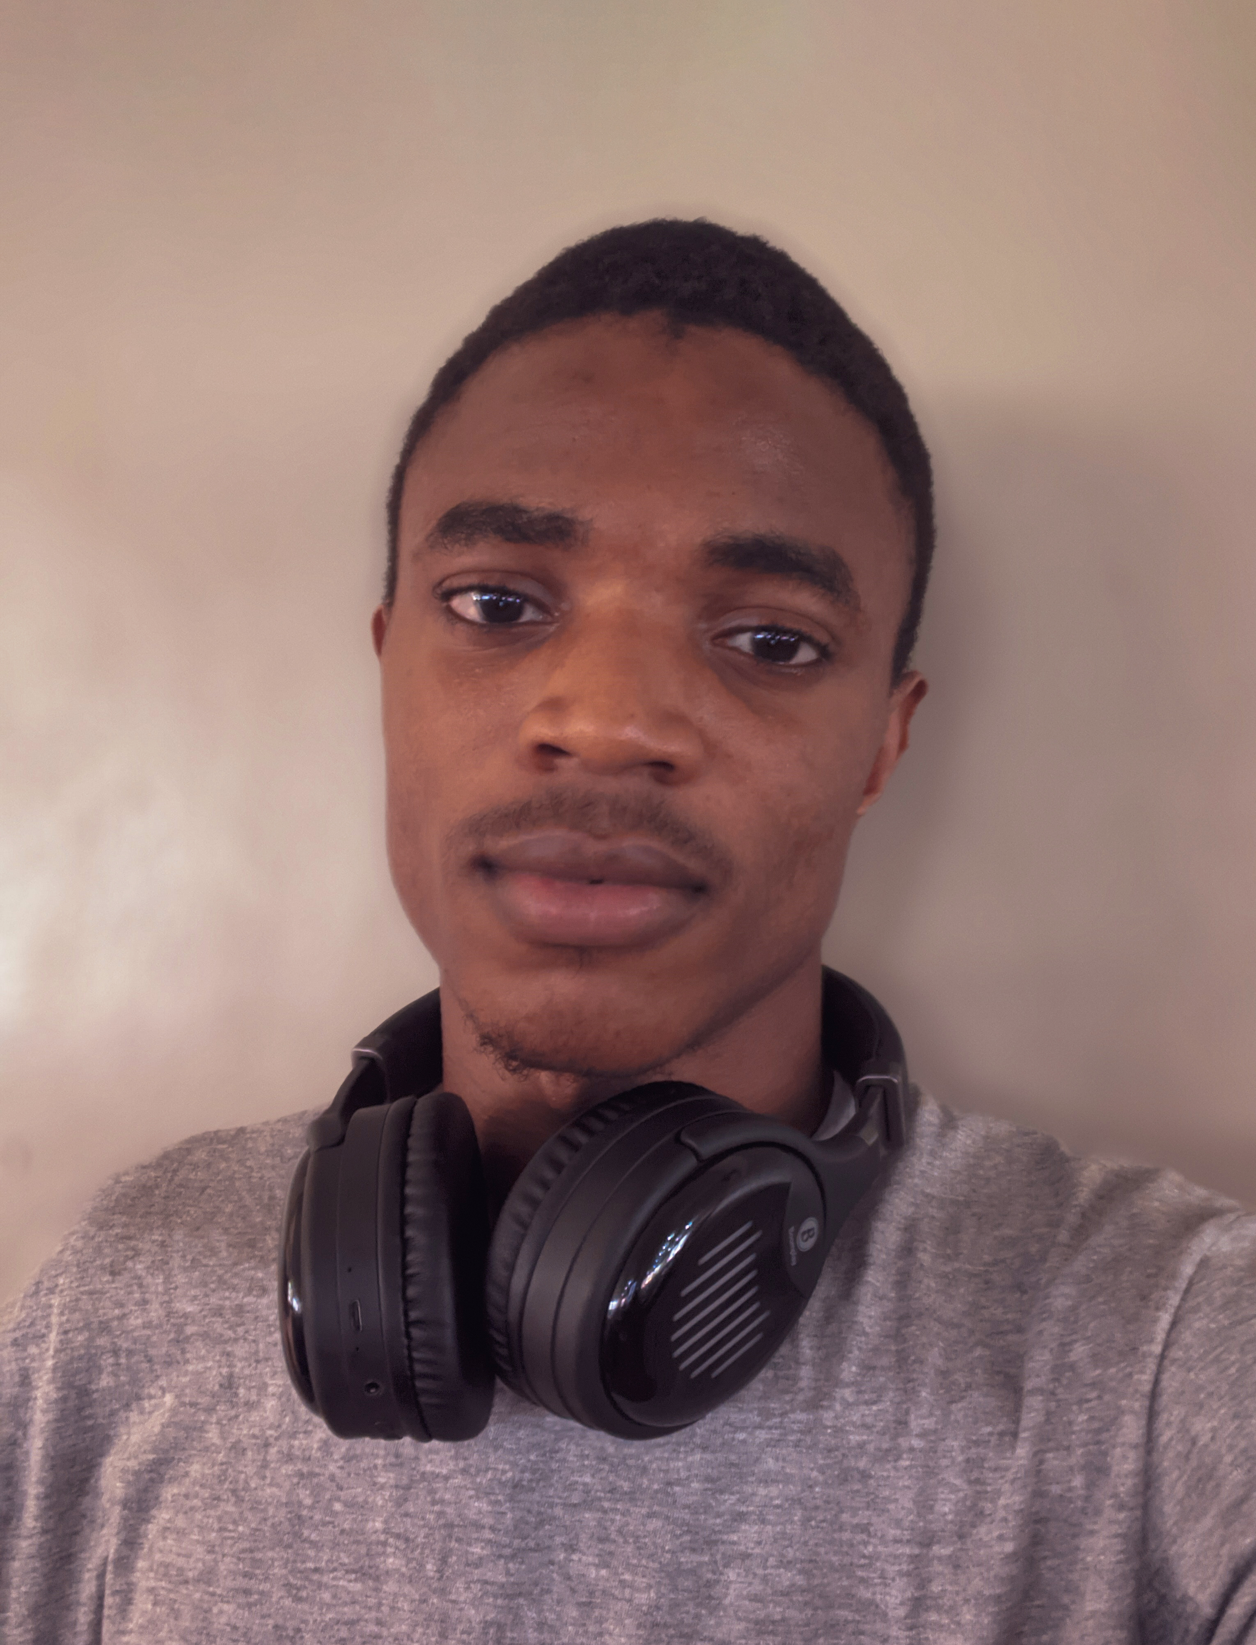
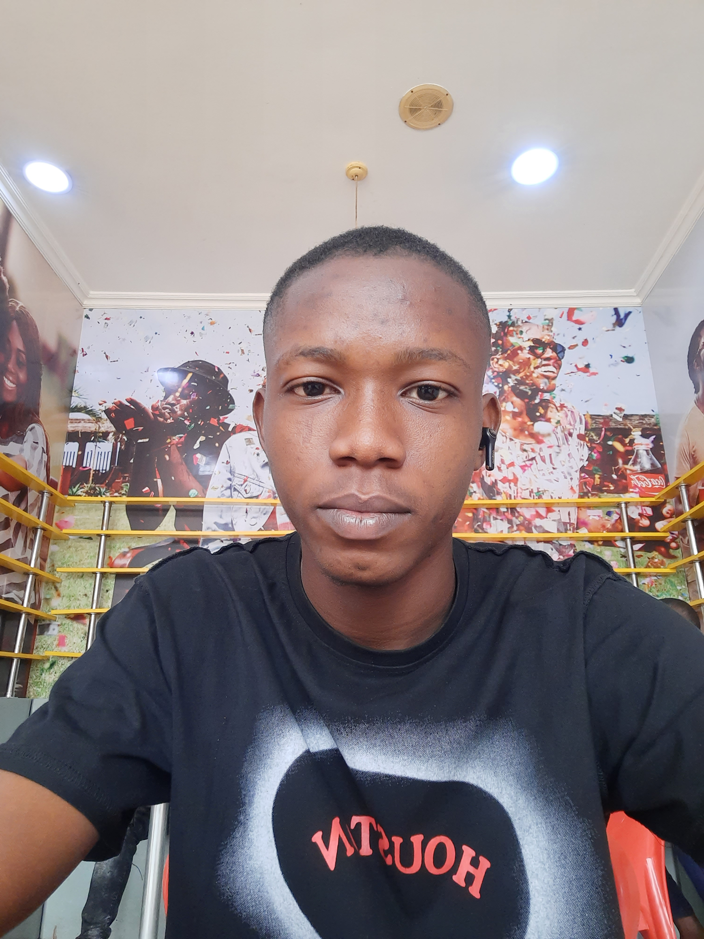
TEAM
We are a Team of Two Passionate Developers aged 20yrs, Blockchain Inclined, and great researchers.
FELIX GOGODAE
AFOLABI OLAJIDE SAMUEL

Slide 10
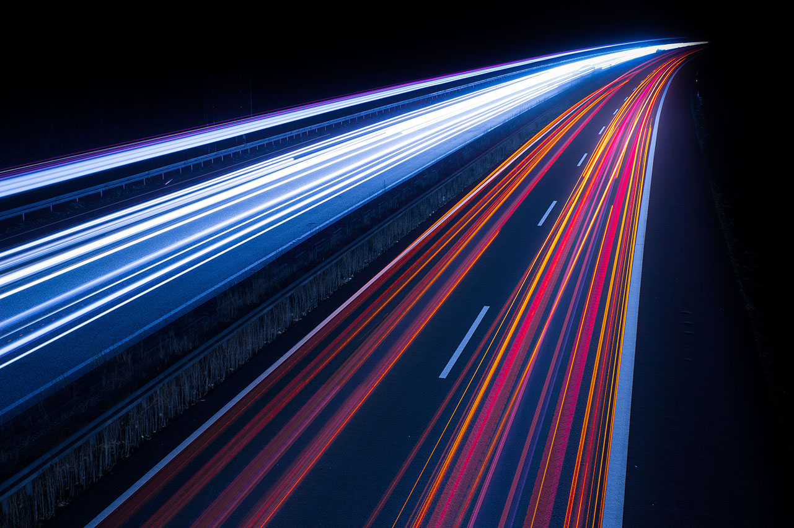
Thank You!

